Slide 1


K.RAMAKRISHNAN COLLEGE OF TECHNOLOGY
(AUTONOMOUS), TRICHY.
DEPARTMENT OF
COMPUTER SCIENCE AND ENGINEERING
20CS5501 DESIGN PROJECT-1
Batch No. : 07
Date : 07.12.2024

Slide 2
SECURED TRANSACTION OF MONEY USING BLOCKCHAIN
Guided by Team
Mrs.V.Kalpana B.Tech,M.E Suvathi R (811722104163)
Assistant Professor, CSE Varsha R K (811722104173)
Varshita M (811722104176)

Slide 3
OBJECTIVE OF THE PROJECT
To design a model of a decentralized web application for secure and transparent money transactions using blockchain technology.
To implement and demonstrate core blockchain principles, including proof-of-work and a distributed ledger, to simulate the functionality of secure transaction systems.
To develop a user-friendly interface that presents transaction details, such as payee name and transfer amount, while backend operations showcase the blockchain's technical aspects, such as hashing and block creation.
To showcase the potential of blockchain technology in providing transparency, data immutability, and enhanced security within the financial domain through a simulated environment.
To provide a model that serves as a foundation for understanding blockchain’s applicability in secure transactions without deploying it in real-world scenarios.

Slide 4
ABSTRACT
This project models a decentralized, transparent, and secure system for managing financial transactions using blockchain technology. It addresses challenges like data security and centralized control by recording transactions on a cryptographically linked distributed ledger. Built with Python and Flask, it provides a user-friendly interface for submitting and viewing transactions, securely storing payee names and transfer amounts. A Proof-of-Work algorithm ensures data integrity by making unauthorized changes computationally infeasible. This model demonstrates blockchain’s potential in secure financial applications, laying the foundation for future enhancements like smart contracts and scalability solutions.

Slide 5
LITERATURE SURVEY
TITLE OF THE PAPER | AUTHOR (S) | PUBLISHER | PAPER GIST | TECHNOLOGY USED
Bitcoin: A Peer-to-Peer Electronic Cash System | Satoshi Nakamoto | Self-published (2008) | Introduces Bitcoin as a decentralized digital currency using Proof-of-Work for secure transactions. | Blockchain, Proof-of-Work (PoW), Cryptography
Blockchain Technology in the Banking Sector: A Review | Raj Jain, Amita Gupta | Springer, 2017 | Reviews blockchain's potential to reduce costs and improve security in the banking sector. | Blockchain, Cryptography, Distributed Ledger Technology (DLT)
Decentralized Payment Systems with Blockchain | Andrea Rossi, Peter Yang | Elsevier, 2019 | Explores blockchain for decentralized, secure, and efficient peer-to-peer payment systems | Blockchain, Cryptography, Decentralized Finance (DeFi)
Smart Contracts and Automated Payment Systems | Nick Szabo, Elena White | IEEE Transactions on Engineering Management, 2020 | Examines how smart contracts can automate financial transactions and reduce costs. | Blockchain, Smart Contracts, Cryptography
Blockchain and Financial Inclusion: The Future of Money Transfers | Jane Doe, Khalid Ahmed | Springer, 2021 | Discusses how blockchain enables low-cost, secure money transfers for the underbanked. | Blockchain, Cryptography, Distributed Ledger Technology (DLT)

Slide 6
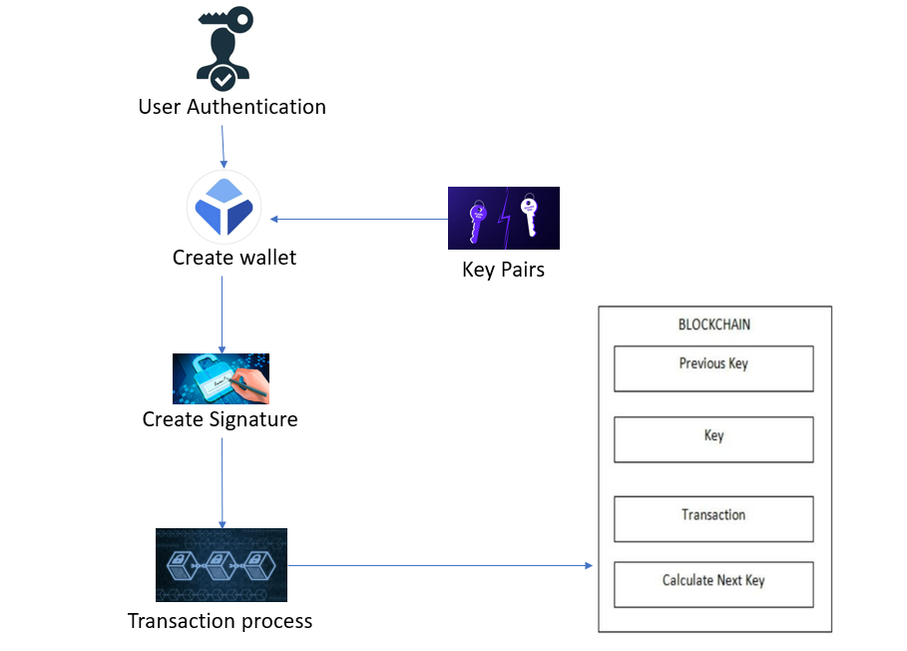
PROPOSED SYSTEM ARCHITECTURE

Slide 7
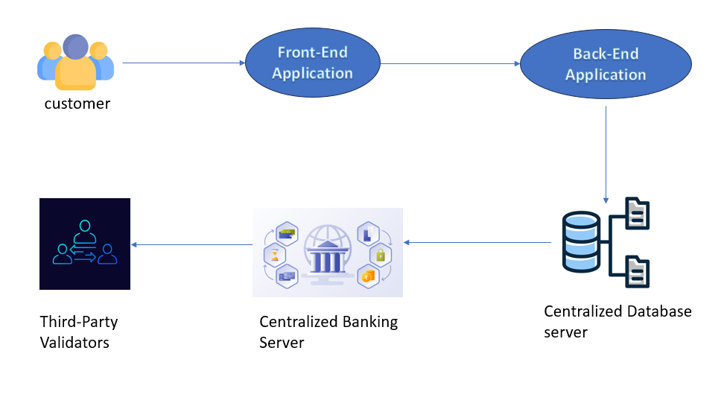
EXISTING SYSTEM ARCHITECTURE

Slide 8
SOFTWARE AND HARDWARE REQUIREMENTS
HARDWARE
SOFTWARE
Computer with at least 4 GB RAM
Processor: Intel i3 or higher
Hard Disk: Minimum 100 GB storage
Stable Internet Connection
Python
Flask Framework
HTML/CSS for user interface
Web browser
Visual Studio Code

Slide 9
MODULES
User registration Module
Transaction management Module
Blockchain ledger Module
Security Encryption Module
Proof-of-work and mining Module
User interface Module

Slide 10
SUMMARY OF MODULE-1
USER REGISTRATION MODULE
The User Registration Module allows users to securely create and manage their accounts by providing necessary details such as names, email and passwords. It includes processes for email verification to ensure valid accounts and password hashing to securely store sensitive information. The module also implements encryption techniques to protect users' personal data from unauthorized access. Additionally, it checks for duplicate registrations and ensures the system remains free of fraud. This module is crucial in ensuring that only authorized users interact with the platform, offering a secure gateway to blockchain-based financial transactions.

Slide 11
SUMMARY OF MODULE-2
TRANSACTION MANAGEMANT MODULE
The Transaction Management Module facilitates the creation, processing, and tracking of financial transactions on the blockchain. It allows users to enter essential details such as payee names, transaction amounts, and relevant dates. The module validates these transactions against the system’s rules before recording them securely on the blockchain ledger. It ensures that each transaction is properly linked to a block and is part of a transparent and immutable chain. The module also allows users to track the status of their transactions, providing feedback on whether the transaction has been confirmed or pending, improving the overall user experience.

Slide 12
SUMMARY OF MODULE-3
BLOCKCHAIN LEDGER MODULE
The Blockchain Ledger Module is the backbone of the system, responsible for securely storing and maintaining an immutable, decentralized ledger of all transactions. Each transaction is recorded in a cryptographically secure block, and blocks are linked together to form a tamper-proof chain. This module ensures the transparency and integrity of the transaction history, making it impossible to alter or delete any data without detection. The distributed nature of the blockchain further enhances security by making it resistant to single points of failure. Users can rely on this module for accurate, verifiable, and transparent transaction records.

Slide 13
SUMMARY OF MODULE-4
SECURITY ENCRYPTION MODULE
The Security Encryption Module safeguards sensitive data such as user credentials, transaction details, and blockchain records by employing advanced encryption techniques. It encrypts data both in transit and at rest, ensuring that sensitive information is not exposed to unauthorized parties. Passwords and private keys are hashed and stored securely to prevent unauthorized access. Additionally, this module uses public and private key pairs for secure communication between users and the blockchain. By applying cryptographic algorithms, this module helps protect the integrity and confidentiality of all system interactions, making the platform secure from external attacks.

Slide 14
SUMMARY OF MODULE-5
PROOF-OF-WORK AND MINING MODULE
The Proof-of-Work (PoW) and Mining Module plays a critical role in securing the blockchain network. Miners must solve complex mathematical problems before they can add a new block to the blockchain. This computationally intensive process ensures that the network remains decentralized and secure by making it difficult for malicious actors to alter transaction data. By rewarding miners with cryptocurrency or tokens for their efforts, this module encourages network participants to maintain the system's integrity. It also ensures that only valid transactions are added to the blockchain, making the ledger tamper-resistant and secure from fraudulent activity.

Slide 15
SUMMARY OF MODULE-6
USER INTERFACE MODULE
The User Interface (UI) Module offers an intuitive platform that enables users to interact with the blockchain without needing technical expertise. It provides a simple interface for users to input transaction details, view transaction status, and manage their accounts. The UI displays relevant data, such as transaction history, payments, and confirmations, making it easy for users to understand their blockchain activities. This module ensures that the backend blockchain processes are abstracted and user-friendly. It also integrates security features such as login authentication and encryption, ensuring a seamless and secure user experience on the platform.

Slide 16
RESULTS AND DISCUSSION
The project successfully demonstrates the use of blockchain for secure, decentralized financial transactions. It ensures transaction validation, data security, and transparency through cryptography and the Proof-of-Work mechanism. The user interface is intuitive, allowing easy management and tracking of transactions. However, scalability, privacy concerns, and transaction costs remain challenges that need addressing.
Future enhancements could include integrating smart contracts, exploring alternative consensus mechanisms like Proof-of-Stake, and improving privacy features. The project provides a solid foundation for future blockchain-based financial systems with potential real-world applications.

Slide 17
CONCLUSION
The project demonstrates blockchain's capability to provide secure, transparent, and decentralized financial transactions, eliminating the need for intermediaries.
By using cryptographic encryption and Proof-of-Work consensus, the system ensures data integrity, secure transaction processing, and protection against unauthorized access.
While the system works effectively, challenges such as scalability and transaction privacy need to be addressed in future iterations for real-world application.
Future improvements can include adopting alternative consensus mechanisms, integrating smart contracts, and enhancing privacy features to further optimize the system for broader use.

Slide 18
THANK YOU

